Slide 1
Spring Boot
06. Spring Data JDBC

Slide 2
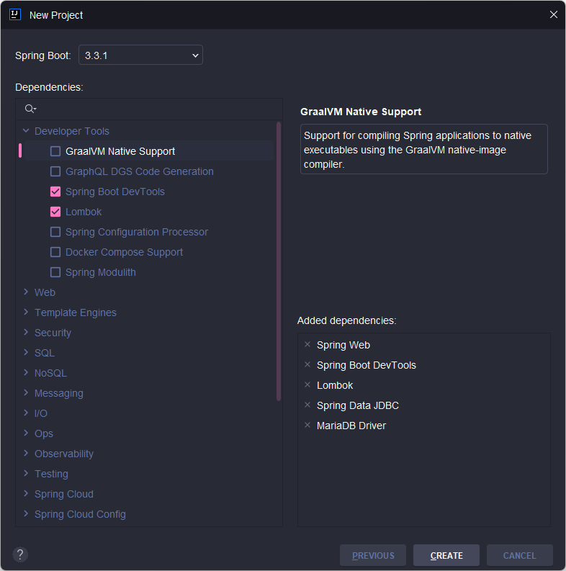
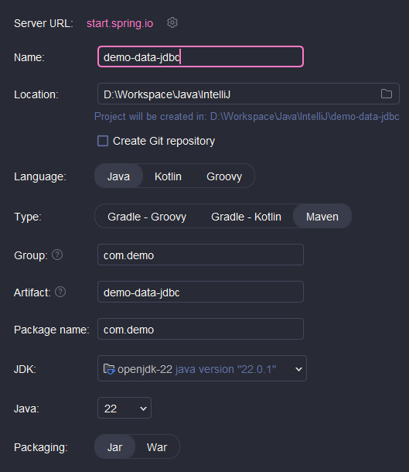
New project
Tạo mới project:

Slide 3
Start project
Cấu hình DB trong application.properties:
spring.datasource.url=jdbc:mariadb://localhost:3306/demo_data_jdbc
spring.datasource.username=root
spring.datasource.password=root

Slide 4
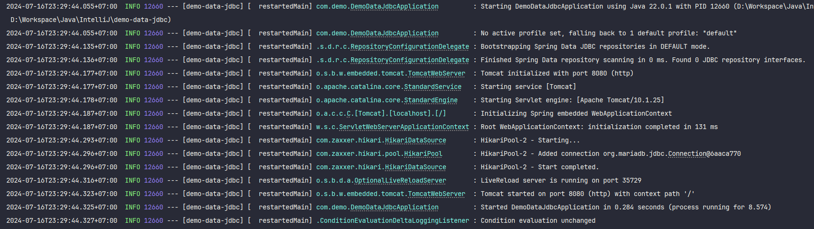
Start project
Start thử server

